Slide 1
数据库原理第七周研讨
第一组

Slide 2
问题1
用SQL,关系代数，写出如下查询：检索同时选修了“08305001”和 “08305002"的学生学号和姓名。（提倡多种表达方式）

Slide 3
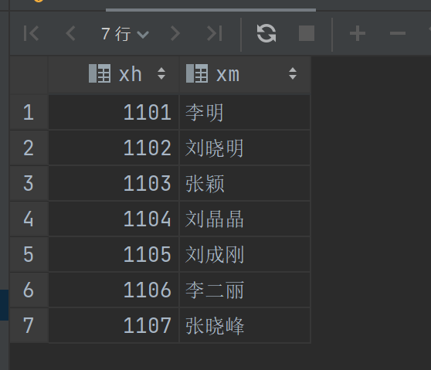
SQL代码
方法1
SELECT student.xh,student.xm FROM student JOIN student_class ON student.Xh = student_class.Xh WHERE student_class.kh in ('8305001', '8305002') GROUP BY student.Xh HAVING COUNT(DISTINCT student_class.kh) = 2;

Slide 4
SQL代码
方法2
SELECT student.Xh, student.xm FROM student WHERE EXISTS ( SELECT * FROM student_class WHERE Xh = student.Xh AND kh = '8305001' ) AND EXISTS ( SELECT * FROM student_class WHERE Xh = student.Xh AND kh = '8305002' );

Slide 5
关系代数
自然连接后，先选择选了要求的两门课的同学，再做一次投影显示他们的学号姓名

Slide 6
问题2
请用关系代数和SQL写出检索同时有3个或3个以上学生选课的老师所在学院名，教师名。

Slide 7
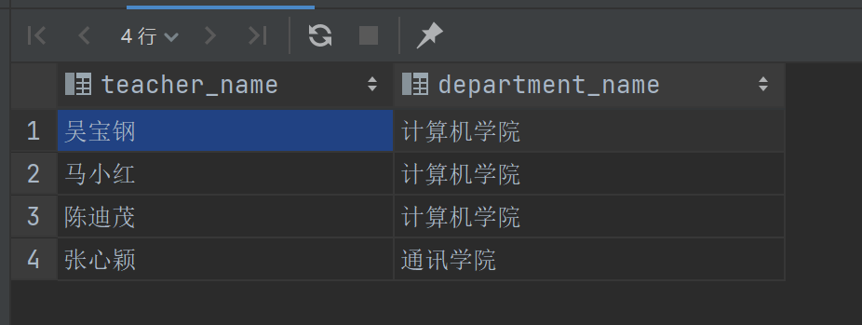
SQL代码
方法1
SELECT teacher.xm AS teacher_name, department.mc AS department_name FROM student_class JOIN teacher ON teacher.gh = student_class.gh JOIN department ON department.yxh = teacher.yxh GROUP BY teacher_name, department_name HAVING COUNT(student_class.xh) >= 3;

Slide 8
SQL代码
方法2
SELECT teacher.xm AS teacher_name, department.mc AS department_name FROM teacher JOIN department ON department.yxh = teacher.yxh WHERE EXISTS ( SELECT 1 FROM student_class WHERE student_class.gh = teacher.gh GROUP BY student_class.gh HAVING COUNT(student_class.xh) >= 3 );

Slide 9
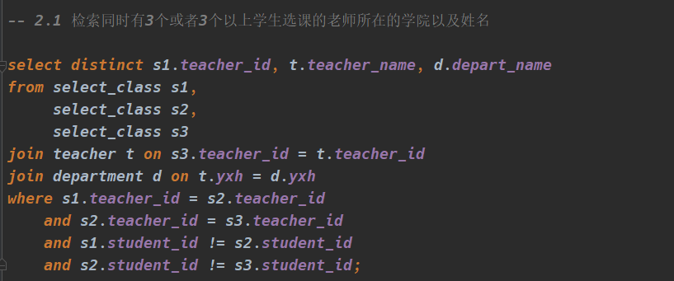
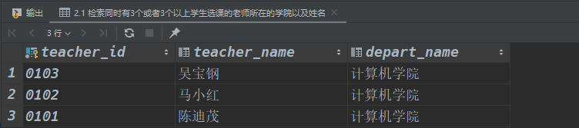

Slide 10
关系代数

Slide 11
问题3
用元组关系演算和关系代数写出如下查询：
1.检索选修课程包含1106同学所学全部课程的
学生学号和姓名。
2.检索刘晓明不学的课程的课程号。

Slide 12
检索选修课程包含1106同学所学全部课程的学生学号和姓名。

Slide 13
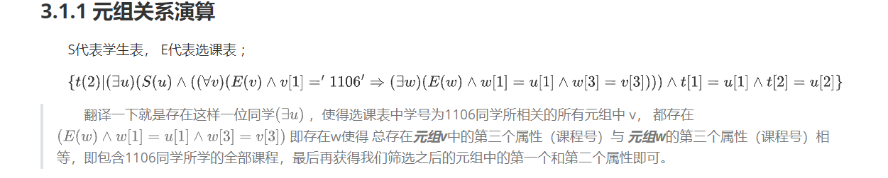
元组关系演算

Slide 14
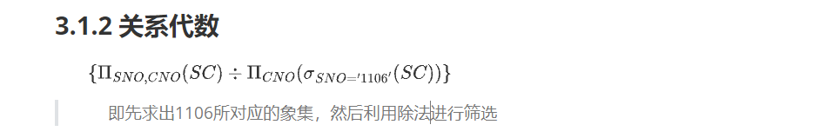
关系代数

Slide 15
检索刘晓明不学的课程的课程号

Slide 16
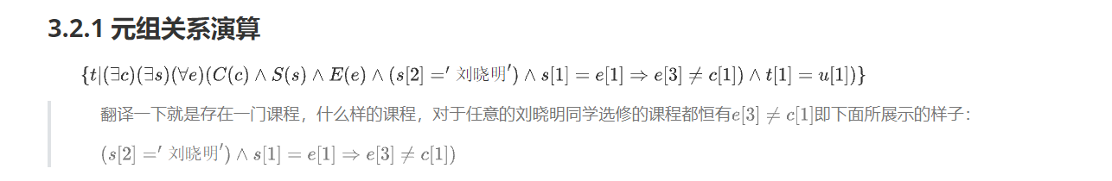
元组关系演算

Slide 17
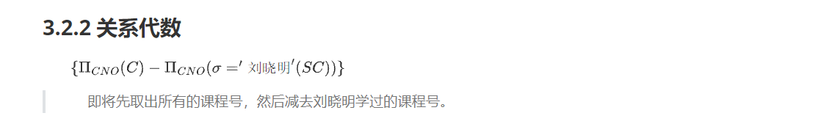
关系代数

